Slide 1

Foundations of Cryptography DES, double DES, triple DES, man-in-the-middle attack, division algorithm, mod, GCD, congruence, $ℤ_{n}^{ }$,$ℤ_{n}^{∗}$
LiangFeng Zhang
zhanglf@shanghaitech.edu.cn

Slide 2





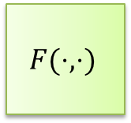












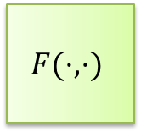


DES Encryption
$56$-bit
secret key $k$
key schedule
$48$-bit
$$k1$$
$$k2$$
$$⋯$$
$$k16$$
$$F(⋅,⋅)$$
$$F(⋅,⋅)$$
$$F(⋅,⋅)$$
$$m$$
$$IP$$
$$⋯$$
$$SW$$
$$IP^{−1}$$
$$c$$
$$L_{0},R_{0}$$
$$L_{1},R_{1}$$
$$L_{2},R_{2}$$
$$L_{16},R_{16}$$
$64$-bit
$64$-bit

Slide 3







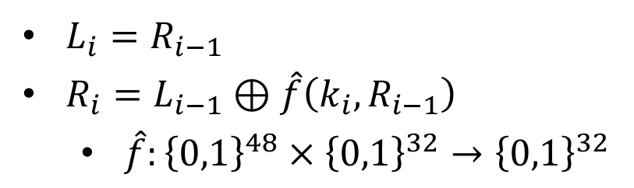
$$F(k_{i},L_{i−1}||R_{i−1})$$
32-bit
32-bit
$$L_{i−1}$$
$R_{i−1}$
$$⊕$$
$L_{i}=R_{i−1}$
$R_{i}=L_{i−1}⊕\hat{f}\left(k_{i}, R_{i−1}\right)$
$\hat{f}:{\left\{0,1\right\}}^{48}×{\left\{0,1\right\}}^{32}→{\left\{0,1\right\}}^{32}$
$$\hat{f}(k_{i},⋅)$$
$L_{i}$
$R_{i}$

Slide 4
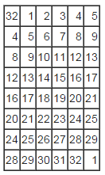
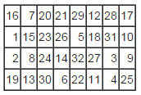
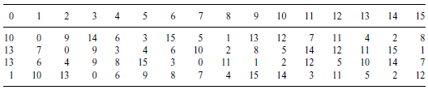























The DES Mangler Function $\hat{f}(k_{i},⋅)$
$$32 bits$$
$$48 bits$$
$R_{i−1}$
$k_{i}$
$$E$$
$$48 bits$$
$$P$$
$$⊕$$
$$48 bits$$
$E$/ expansion function
$$S1$$
$$S2$$
$$S3$$
$$S4$$
$$S5$$
$$S6$$
$$S7$$
$$S8$$
$$32 bits$$
$$P$$
$$S3$$
$$\hat{f}(k_{i},R_{i−1})$$

Slide 5
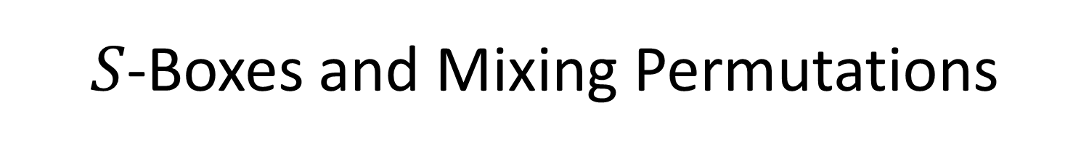
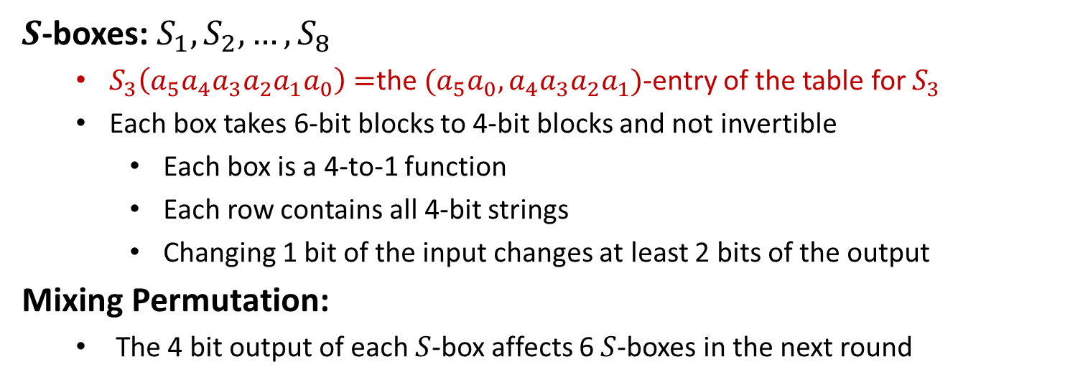
$S$-Boxes and Mixing Permutations
$S$-boxes: $S_{1}, S_{2},…,S_{8}$
$S_{3}\left(a_{5}a_{4}a_{3}a_{2}a_{1}a_{0}\right)=$the $(a_{5}a_{0},a_{4}a_{3}a_{2}a_{1})$-entry of the table for $S_{3}$
Each box takes 6-bit blocks to 4-bit blocks and not invertible
Each box is a 4-to-1 function
Each row contains all 4-bit strings
Changing 1 bit of the input changes at least 2 bits of the output
Mixing Permutation:
The 4 bit output of each $S$-box affects 6 $S$-boxes in the next round

Slide 6




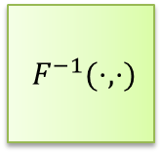







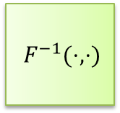








DES Decryption
$56$-bit
secret key $k$
key expansion
$48$-bit
$$k1$$
$$k2$$
$$⋯$$
$$k16$$
$F^{−1}(⋅,⋅)$
$F^{−1}(⋅,⋅)$
$F^{−1}(⋅,⋅)$
$$m$$
$$IP^{−1}$$
$$⋯$$
$$IP$$
$$SW$$
$$c$$
$$L_{0},R_{0}$$
$$L_{1},R_{1}$$
$$L_{2},R_{2}$$
$$L_{16},R_{16}$$
$64$-bit
$64$-bit
The DES Decryption: inverse $F\left(k_{1},⋅\right),…,F(k_{16},⋅)$
$R_{i−1}=L_{i}, L_{i−1}=R_{i}⊕\hat{f}(k_{i},L_{i})$

Slide 7
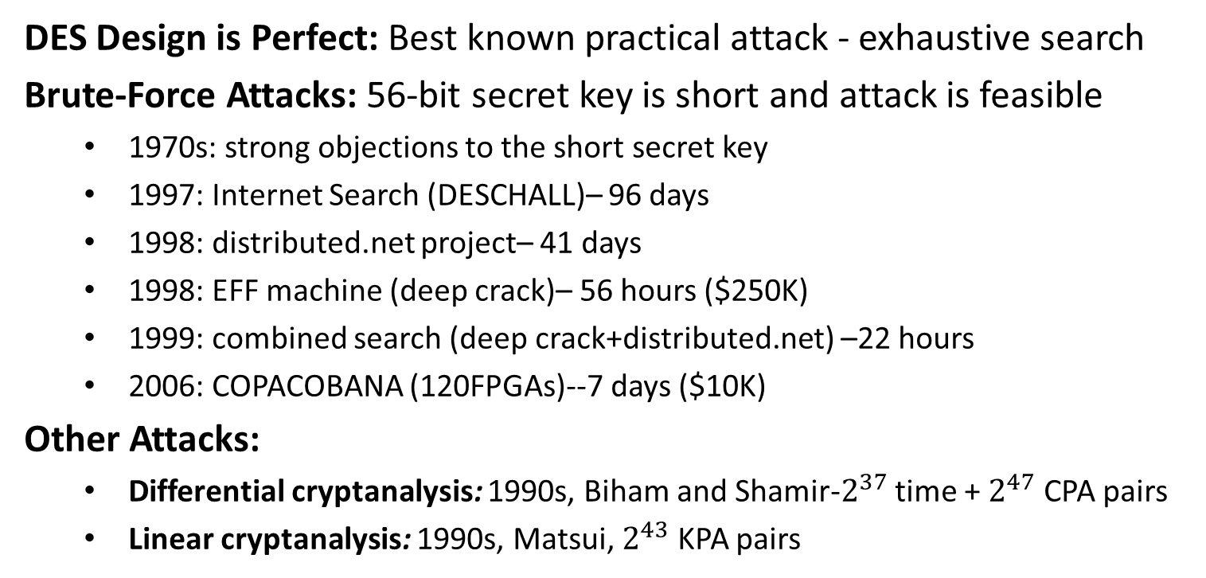
Security
DES Design is Perfect: Best known practical attack - exhaustive search
Brute-Force Attacks: 56-bit secret key is short and attack is feasible
1970s: strong objections to the short secret key
1997: Internet Search (DESCHALL)– 96 days
1998: distributed.net project– 41 days
1998: EFF machine (deep crack)– 56 hours ($250K)
1999: combined search (deep crack+distributed.net) –22 hours
2006: COPACOBANA (120FPGAs)--7 days ($10K)
Other Attacks:
Differential cryptanalysis: 1990s, Biham and Shamir-$2^{37}$ time + $2^{47}$ CPA pairs
Linear cryptanalysis: 1990s, Matsui, $2^{43}$ KPA pairs

Slide 8
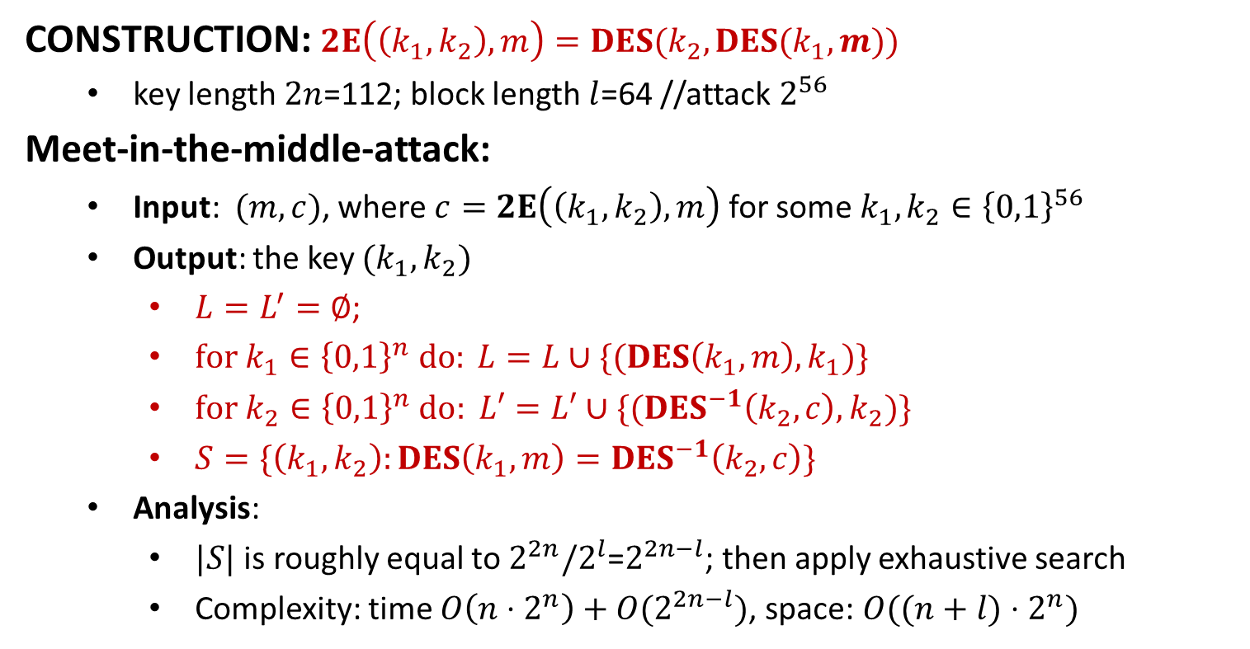
Double DES
CONSTRUCTION: $2E\left(\left(k_{1},k_{2}\right), m\right)=DES(k_{2},DES(k_{1},m))$
key length $2n$=112; block length $l$=64 //attack $2^{56}$
Meet-in-the-middle-attack:
Input: $(m,c)$, where $c=2E\left(\left(k_{1},k_{2}\right), m\right)$ for some $k_{1},k_{2}∈{\left\{0,1\right\}}^{56}$
Output: the key $(k_{1},k_{2})$
$L=L^{′}=∅$;
$for k_{1}∈{\left\{0,1\right\}}^{n} do: L=L∪\{(DES\left(k_{1},m\right),k_{1})\}$
$for k_{2}∈{\left\{0,1\right\}}^{n}$ $do: L′=L′∪\{(DES^{−1}\left(k_{2},c\right), k_{2})\}$
$S=\{\left(k_{1},k_{2}\right):DES\left(k_{1},m\right)=DES^{−1}\left(k_{2},c\right)\}$
Analysis:
$|S|$ is roughly equal to $2^{2n}/2^{l}$=$2^{2n−l}$; then apply exhaustive search
Complexity: time $O\left(n⋅2^{n}\right)+O(2^{2n−l})$, space: $O((n+l)⋅2^{n})$

Slide 9
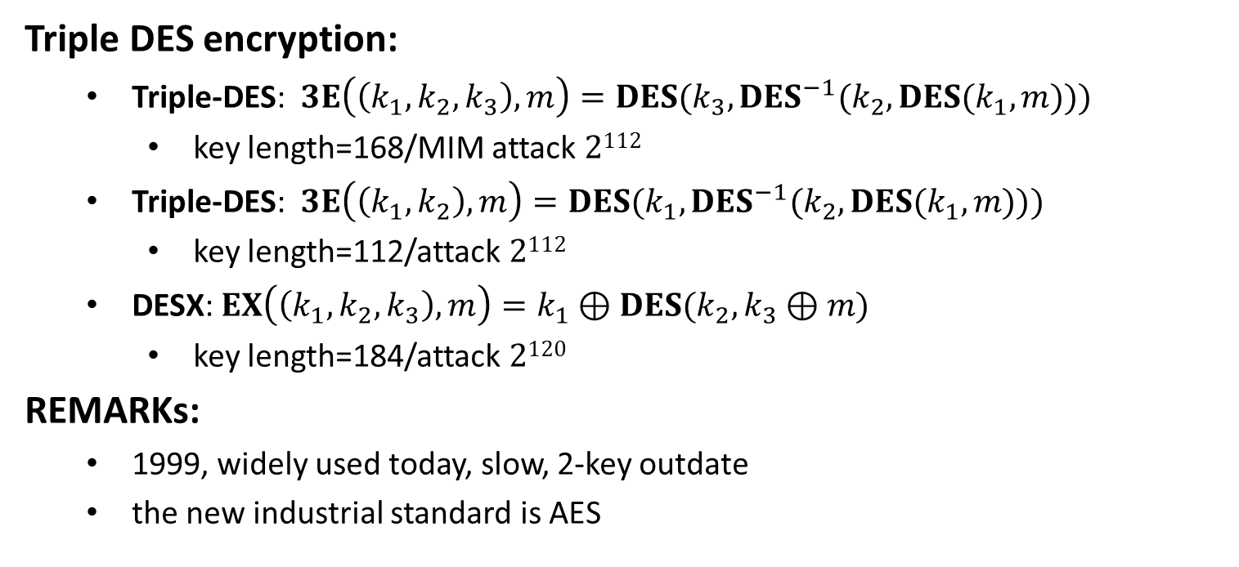
Other Extensions
Triple DES encryption:
Triple-DES: $3E\left(\left(k_{1},k_{2},k_{3}\right), m\right)=DES(k_{3},DES^{−1}(k_{2},DES(k_{1},m)))$
key length=168/MIM attack $2112$
Triple-DES: $3E\left(\left(k_{1},k_{2}\right), m\right)=DES(k_{1},DES^{−1}(k_{2},DES(k_{1},m)))$
key length=112/attack $2112$
DESX: $EX\left(\left(k_{1},k_{2},k_{3}\right),m\right)=k_{1}⊕DES(k_{2},k_{3}⊕m)$
key length=184/attack $2120$
REMARKs:
1999, widely used today, slow, 2-key outdate
the new industrial standard is AES

Slide 10
Advanced Encryption Standard (AES)
Background: FIPS 197
1997: NIST called for Advanced Encryption Standard
1998: 15 proposals were submitted/ the 1st AES workshop
1999: 5 submissions were selected/the 2nd AES workshop
2000: NIST adopted Rijndael (Belgium) /the 3rd AES workshop
REMARKs:
key length: 128-bit, 192-bit, or 256-bit
block length: 128-bit
number of rounds: 10, 12, 14
suitable for software & hardware implementations
key recovery attack: 4 times better than brute-force attack
substation-permutation network

Slide 11

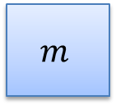





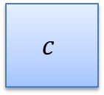
AES Encryption (128-bit key)
128-bit
secret key $k$
key expansion
128-bit
$$k0$$
$$k1$$
$$k2$$
$$k10$$
AddRoundKey
4
4
SubBytes
ShiftRows
MixColumns
SubBytes
ShiftRows
MixColumns
SubBytes
ShiftRows
$$m$$
⨁
$$c$$
4
⨁
⨁
⨁
⨁
4
Round 1
Round 2
Round 10
Message/Ciphertext: a matrix of 16 byte, called state
Key schedule: 128-bit secret key$→$ 11 round keys (128-bit)
Round 1-Round 9: AddRoundKey, SubBytes, ShiftRows, MixColumns
Round 10: AddRoundKey, SubBytes, ShiftRows, AddRoundKey

Slide 13
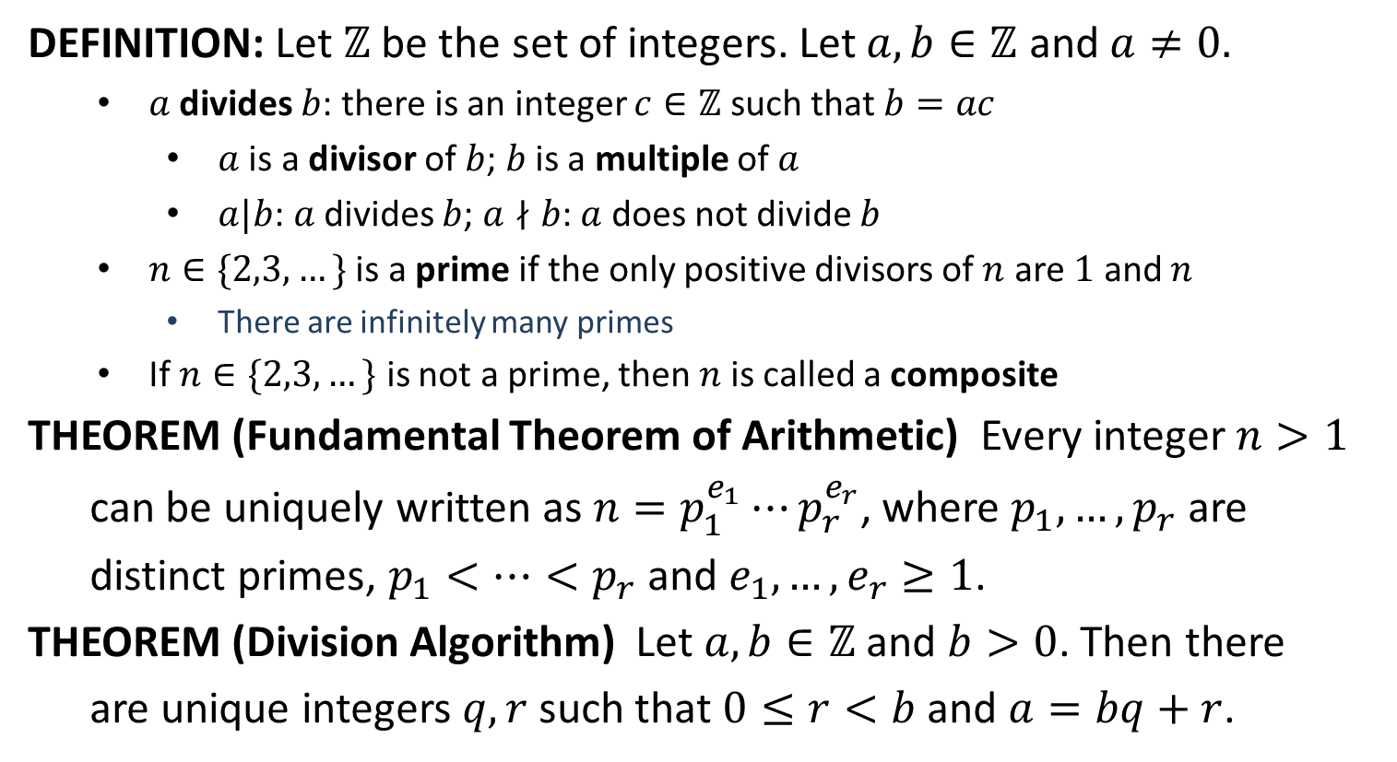
Divisibility
DEFINITION: Let $ℤ$ be the set of integers. Let $a,b∈ℤ$ and $a≠0.$
$a$ divides $b$: there is an integer $c∈ℤ$ such that $b=ac$
$a$ is a divisor of $b$; $b$ is a multiple of $a$
$a|b$: $a$ divides $b$; $a∤b$: $a$ does not divide $b$
$n∈\{2,3,…\}$ is a prime if the only positive divisors of $n$ are $1$ and $n$
There are infinitely many primes
If $n∈\{2,3,…\}$ is not a prime, then$n$is called a composite
THEOREM (Fundamental Theorem of Arithmetic) Every integer $n>1$
can be uniquely written as $n=p_{1}^{e_{1}}⋯p_{r}^{e_{r}}$, where $p_{1},…,p_{r}$ are
distinct primes, $p_{1}<…<p_{r}$ and $e_{1},…,e_{r}≥1$.
THEOREM (Division Algorithm) Let $a,b∈ℤ$ and $b>0$. Then there
are unique integers $q,r$ such that $0≤r<b$ and $a=bq+r$.

Slide 14

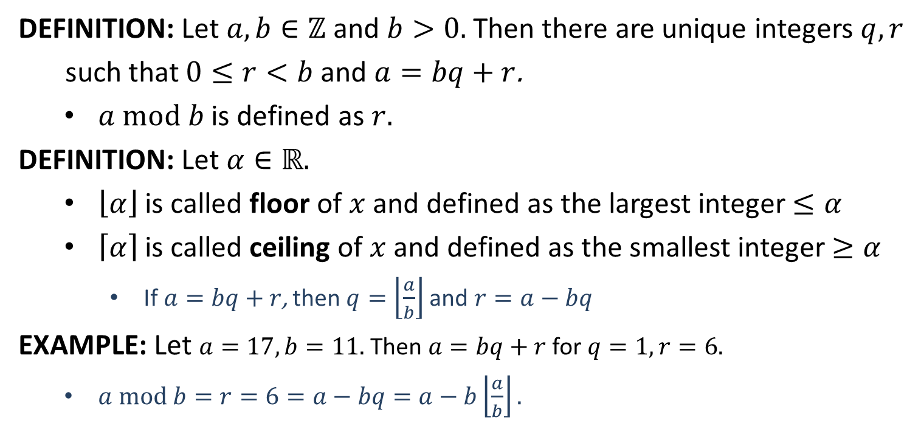
$$mod$$
DEFINITION: Let $a,b∈ℤ$ and $b>0.$ Then there are unique integers $q,r$
such that $0≤r<b$ and $a=bq+r$.
$a mod b$ is defined as $r.$
DEFINITION: Let $α∈ℝ.$
$\left\lfloor α\right\rfloor$ is called floor of $x$ and defined as the largest integer $≤α$
$\left\lceil α\right\rceil$ is called ceiling of $x$ and defined as the smallest integer $≥α$
If $a=bq+r$, then $q=\left\lfloor \frac{a}{b}\right\rfloor$ and $r=a−bq$
EXAMPLE: Let $a=17, b=11.$ Then $a=bq+r$ for $q=1, r=6.$
$a mod b=r=6=a−bq=a−b\left\lfloor \frac{a}{b}\right\rfloor .$

Slide 15
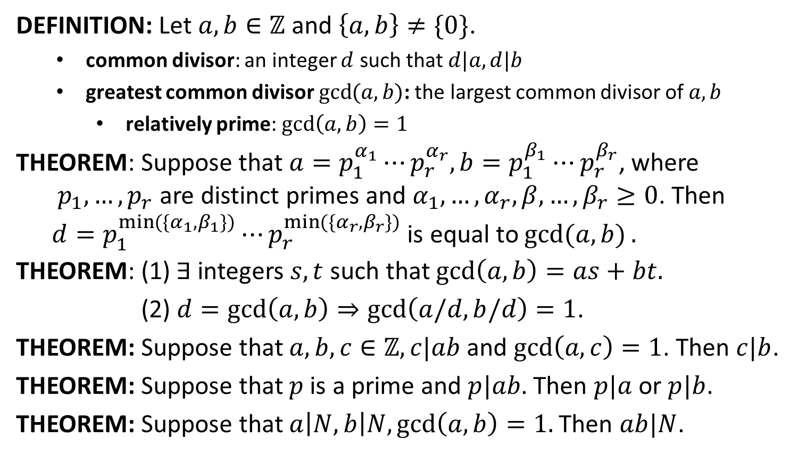
Greatest Common Divisor
DEFINITION: Let $a,b∈ℤ$ and $\left\{a,b\right\}≠\{0\}$.
common divisor: an integer $d$ such that $d|a, d|b$
greatest common divisor $\gcd{(a,b)}$: the largest common divisor of $a,b$
relatively prime: $\gcd\left(a,b\right)=1$
THEOREM: Suppose that $a=p_{1}^{α_{1}}⋯p_{r}^{α_{r}}, b=p_{1}^{β_{1}}⋯p_{r}^{β_{r}}$, where
$p_{1},…,p_{r}$ are distinct primes and $α_{1},…,α_{r},β,…,β_{r}≥0$. Then
$d=p_{1}^{\min{(\{α_{1},β_{1}\})}}⋯p_{r}^{\min{(\{α_{r},β_{r}\})}}$ is equal to $\gcd{(a,b)}.$
THEOREM: (1) $∃$ integers $s,t$ such that $\gcd\left(a,b\right)=as+bt.$
(2) $d=\gcd\left(a,b\right)⇒\gcd\left(a/d,b/d\right)=1$.
THEOREM: Suppose that $a,b,c∈ℤ, c|ab$and $\gcd\left(a,c\right)=1$. Then $c|b$.
THEOREM: Suppose that $p$ is a prime and $p|ab$. Then $p|a$ or $p|b$.
THEOREM: Suppose that $a\left|N, b\right|N,\gcd\left(a,b\right)=1.$Then $ab|N$.

Slide 16
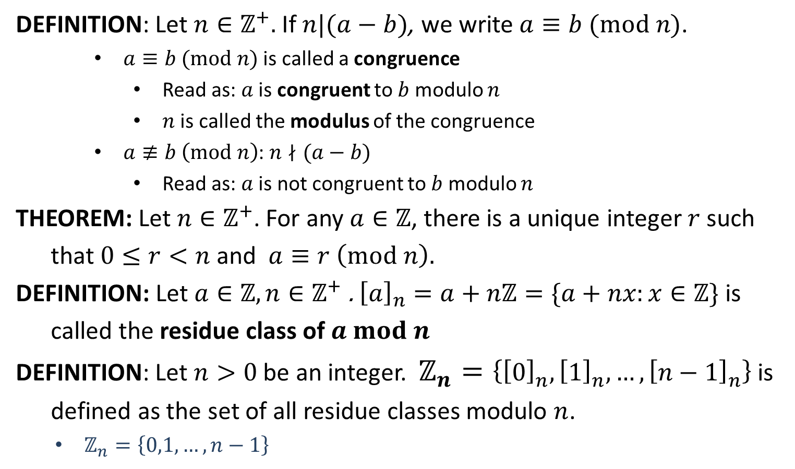
Congruence
DEFINITION: Let $n∈ℤ^{+}.$ If $n|(a−b)$, we write $a≡b (mod n)$.
$a≡b (mod n)$ is called a congruence
Read as: $a$ is congruent to $b$ modulo $n$
$n$ is called the modulus of the congruence
$a≢b \left(mod n\right)$: $n∤(a−b)$
Read as: $a$ is not congruent to $b$ modulo $n$
THEOREM: Let $n∈ℤ^{+}$. For any $a∈ℤ$, there is a unique integer $r$ such
that $0≤r<n$ and $a≡r \left(mod n\right).$
DEFINITION: Let $a∈ℤ,n∈ℤ^{+}$. ${\left[a\right]}_{n}=a+nℤ=\{a+nx:x∈ℤ\}$ is
called the residue class of $a mod n$
DEFINITION: Let $n>0$ be an integer. $ℤ_{n}=\left\{{\left[0\right]}_{n}, {\left[1\right]}_{n}, …, {\left[n−1\right]}_{n}\right\}$ is
defined as the set of all residue classes modulo $n$.
$ℤ_{n}=\left\{0,1,…,n−1\right\}$

Slide 17

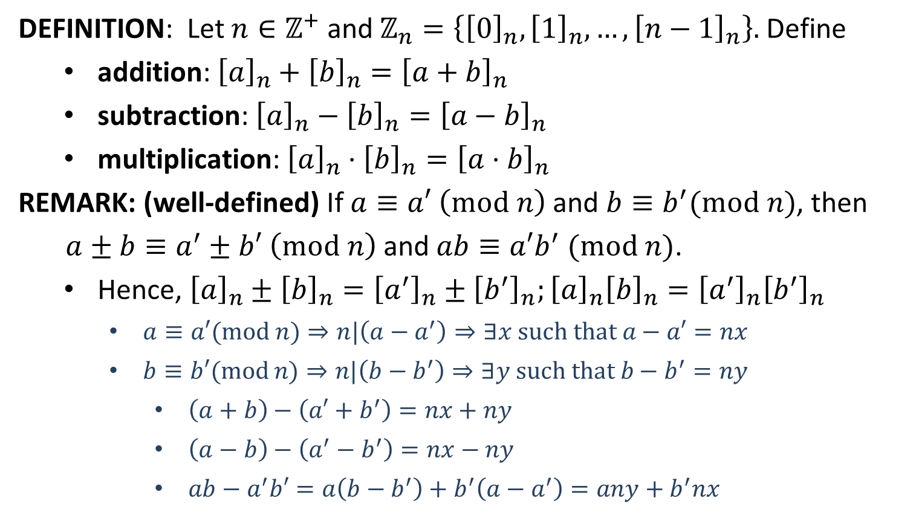
$ℤ_{n}$
DEFINITION: Let $n∈ℤ^{+}$ and $ℤ_{n}=\left\{{\left[0\right]}_{n}, {\left[1\right]}_{n}, …, {\left[n−1\right]}_{n}\right\}.$ Define
addition: ${\left[a\right]}_{n}+{\left[b\right]}_{n}={\left[a+b\right]}_{n}$
subtraction: ${\left[a\right]}_{n}−{\left[b\right]}_{n}={\left[a−b\right]}_{n}$
multiplication: ${\left[a\right]}_{n}⋅{\left[b\right]}_{n}={\left[a⋅b\right]}_{n}$
REMARK: (well-defined) If $a≡a′ \left(mod n\right)$ and $b≡b^{′}(mod n)$, then
$a±b≡a^{′}±b′ \left(mod n\right)$ and $ab≡a′b^{′} (mod n)$.
Hence, ${\left[a\right]}_{n}±{\left[b\right]}_{n}={\left[a^{′}\right]}_{n}±{\left[b^{′}\right]}_{n};{\left[a\right]}_{n}{\left[b\right]}_{n}={\left[a^{′}\right]}_{n}{\left[b^{′}\right]}_{n}$
$a≡a′(mod n)⇒n|\left(a−a^{′}\right)⇒∃x such that a−a′=nx$
$b≡b′(mod$ $n)⇒n|\left(b−b^{′}\right)⇒∃y such that b−b^{′}=ny$
$\left(a+b\right)−\left(a′+b^{′}\right)=nx+ny$
$\left(a−b\right)−\left(a^{′}−b^{′}\right)=nx−ny$
$ab−a^{′}b′=a\left(b−b^{′}\right)+b^{′}\left(a−a^{′}\right)=any+b^{′}nx$

Slide 18

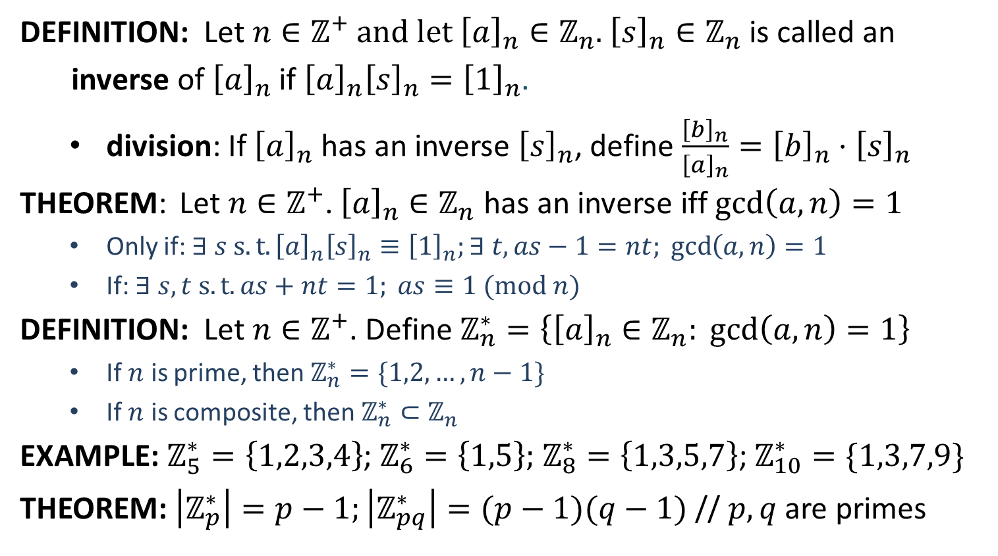
$$ℤ_{n}^{∗}$$
DEFINITION: Let $n∈ℤ^{+}$ and let ${\left[a\right]}_{n}∈ℤ_{n}$. ${\left[s\right]}_{n}∈ℤ_{n}$ is called an
inverse of ${\left[a\right]}_{n}$ if ${\left[a\right]}_{n}{\left[s\right]}_{n}={\left[1\right]}_{n}$.
division: If ${\left[a\right]}_{n}$ has an inverse ${\left[s\right]}_{n}$, define $\frac{{\left[b\right]}_{n}}{{\left[a\right]}_{n}}={\left[b\right]}_{n}⋅{\left[s\right]}_{n}$
THEOREM: Let $n∈ℤ^{+}$. ${\left[a\right]}_{n}∈ℤ_{n}$ has an inverse iff $\gcd\left(a,n\right)=1$
Only if: $∃ s s.t. {\left[a\right]}_{n}{\left[s\right]}_{n}≡{\left[1\right]}_{n};$ $∃ t, as−1=nt; \gcd\left(a,n\right)=1$
If: $∃ s,t s.t. as+nt=1; as≡1 (mod n)$
DEFINITION: Let $n∈ℤ^{+}$. Define $ℤ_{n}^{∗}=\left\{{\left[a\right]}_{n}∈ℤ_{n}: \gcd\left(a,n\right)=1\right\}$
If $n$ is prime, then $ℤ_{n}^{∗}=\{1,2,…,n−1\}$
If $n$ is composite, then $ℤ_{n}^{∗}⊂ℤ_{n}$
EXAMPLE: $ℤ_{5}^{∗}=\left\{1,2,3,4\right\}$; $ℤ_{6}^{∗}=\left\{1,5\right\};$ $ℤ_{8}^{∗}=\left\{1,3,5,7\right\}$; $ℤ_{10}^{∗}=\{1,3,7,9\}$
THEOREM: $\left|ℤ_{p}^{∗}\right|=p−1;\left|ℤ_{pq}^{∗}\right|=(p−1)(q−1)$ // $p,q$ are primes

